Slide 1
MLL Resolution
Error function fitting

Slide 2
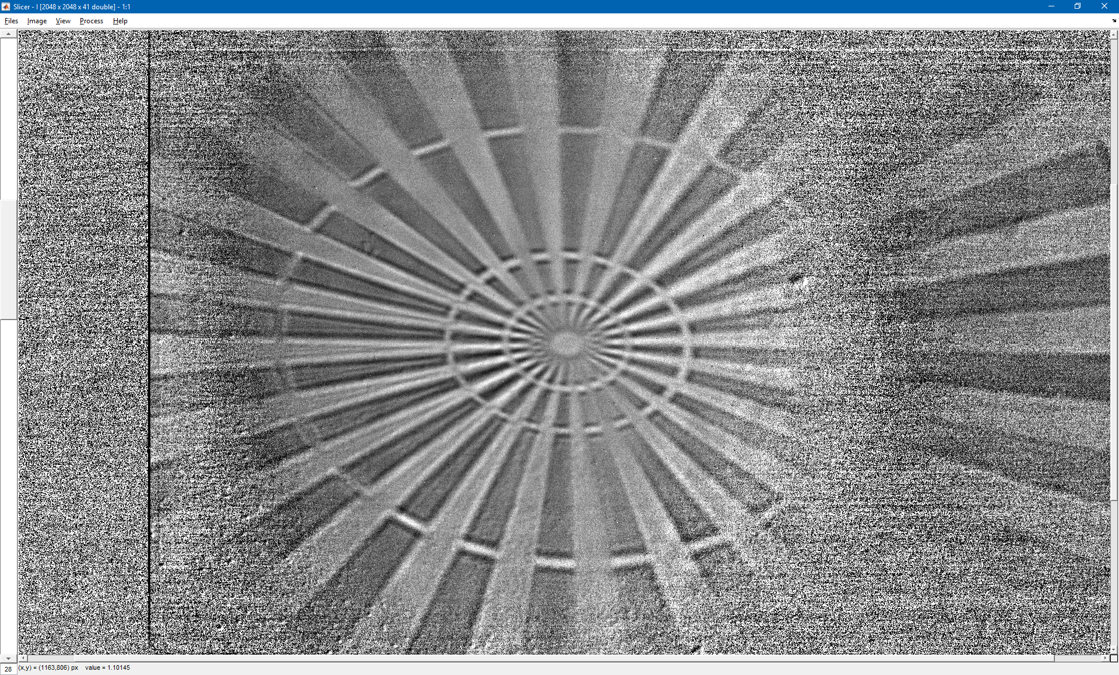
Horizontal ROI top

Slide 3
Horizontal ROI top fit
Fitting an error function with a width corresponding to the RMS of a Gaussian convolution of a sharp step. So the reported resolution (σ) is the RMS width of the point spread function.
The error on the fit is given at 1 standard deviation.
σ = (42.4±3.3) nm
M = 60.8

Slide 4
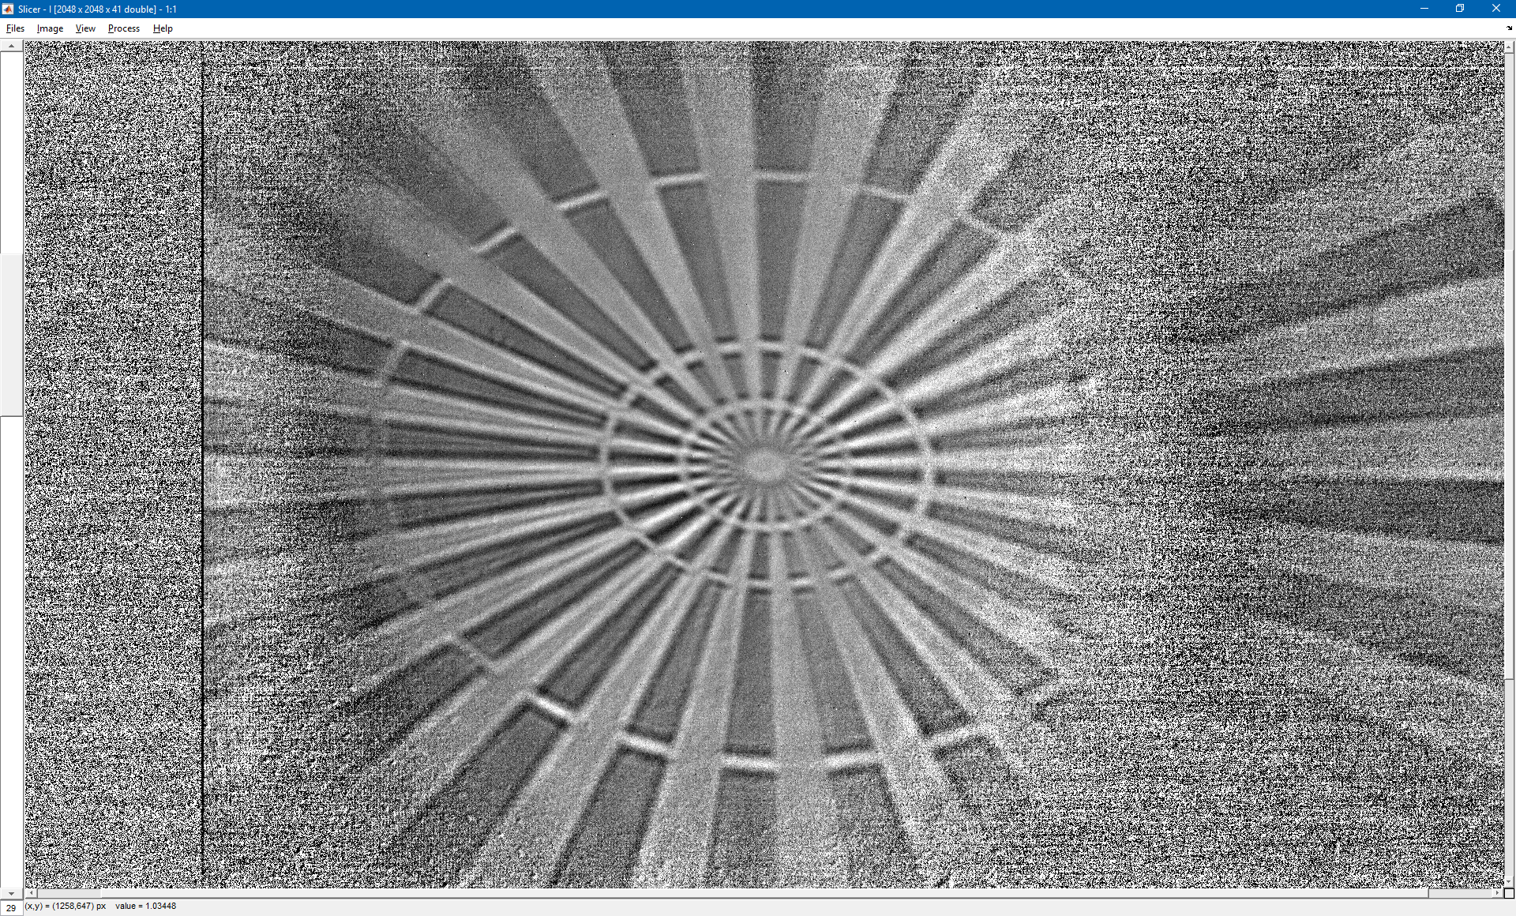
Horizontal ROI bottom

Slide 5
Horizontal ROI bottom fit
σ = (29.5±3.7) nm
M = 60.8

Slide 6
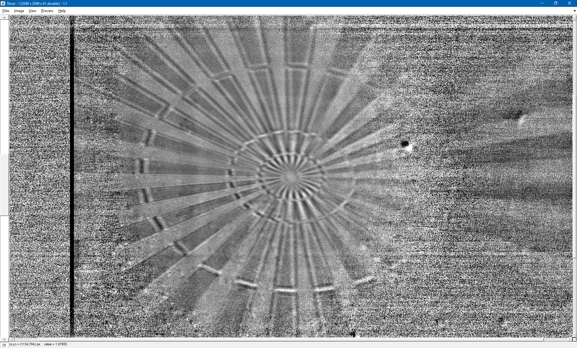
Vertical ROI left

Slide 7
Vertical ROI left fit
σ = (11.0±2.3) nm
M = 46.0

